Slide 1
Timely and Effective Care
Explore the Hospital Care in US
Connie Zhang

Slide 2
Timely and Effective Care
Health Care is an important subject to individual, company and government.
Health Care spending increases rapidly.
Many factors contribute to the increase: patient, doctor, hospital
We are looking at one of them:
Timely and effective care from hospital on several medical conditions.

Slide 3
Timely and Effective Care
The project covers the following conditions:
(1) Colonoscopy Care
(2) children's asthma care
(3) heart failure care
(4) pneumonia care
(5) preventive care
(6) pregnancy and delivery care

Slide 4
Timely and Effective Care
The data for this project :
https://catalog.data.gov/dataset/timely-and-effective-care-hospital-e4aad
The goal of the project:
Supply a tool for user who are interested in the subject to investigate the health care quality within and across states.

Slide 5
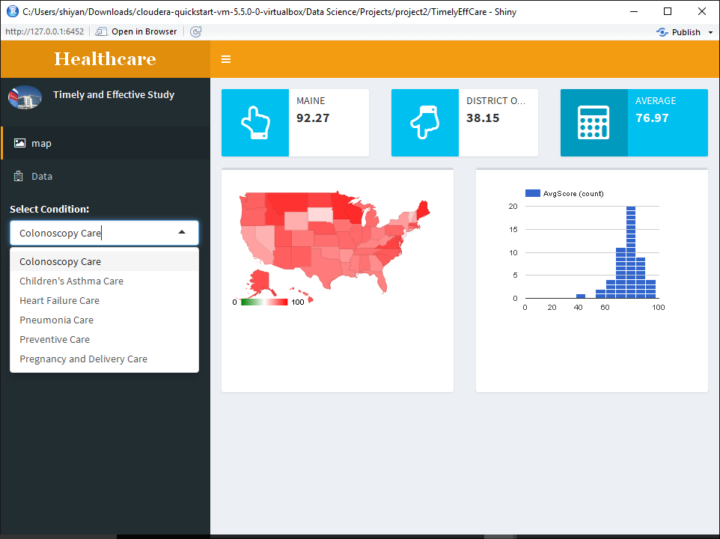
Timely and Effective Care

Slide 6
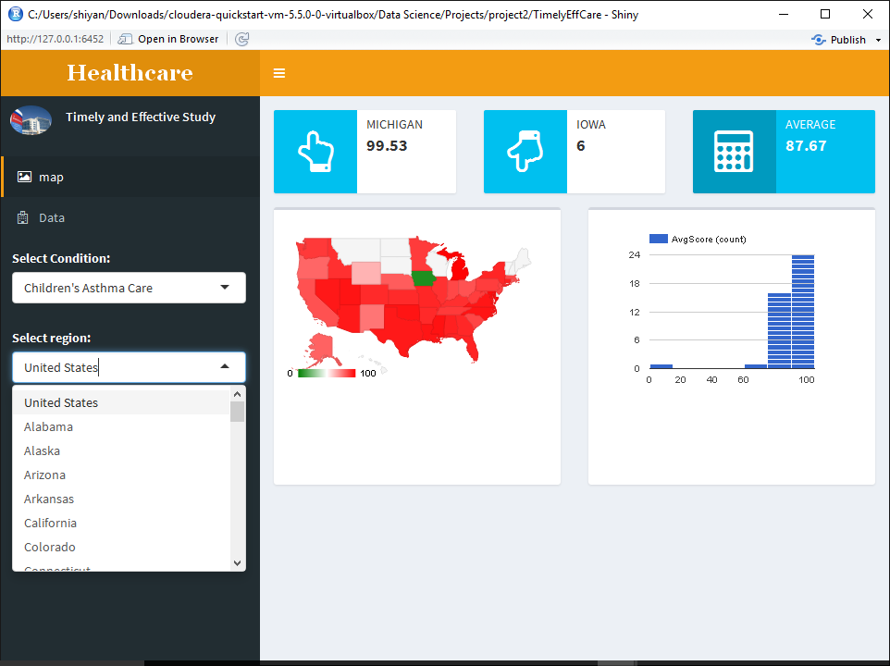
Timely and Effective Care

Slide 7
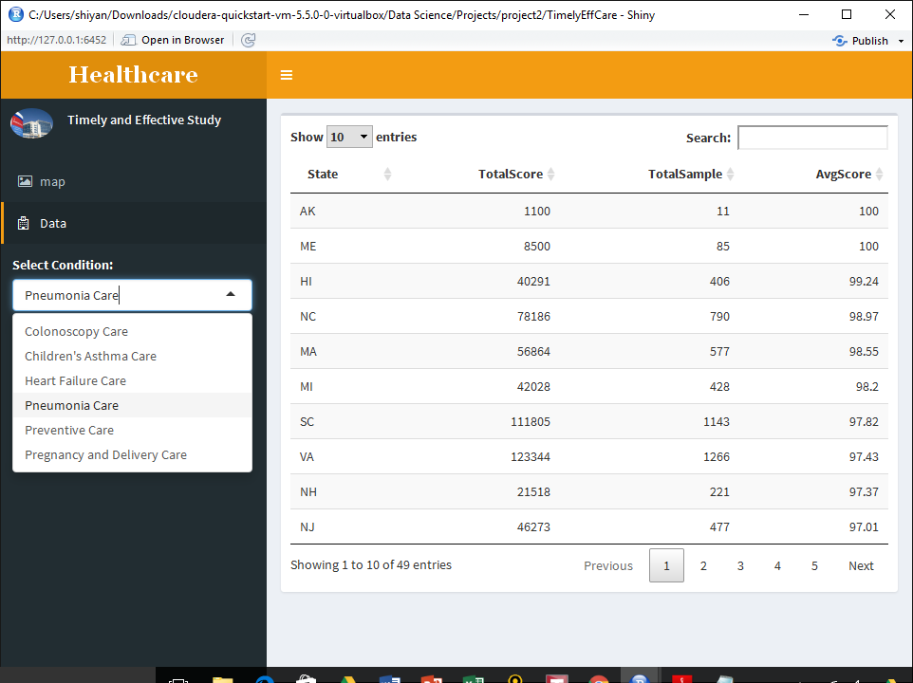
Timely and Effective Care

Slide 8
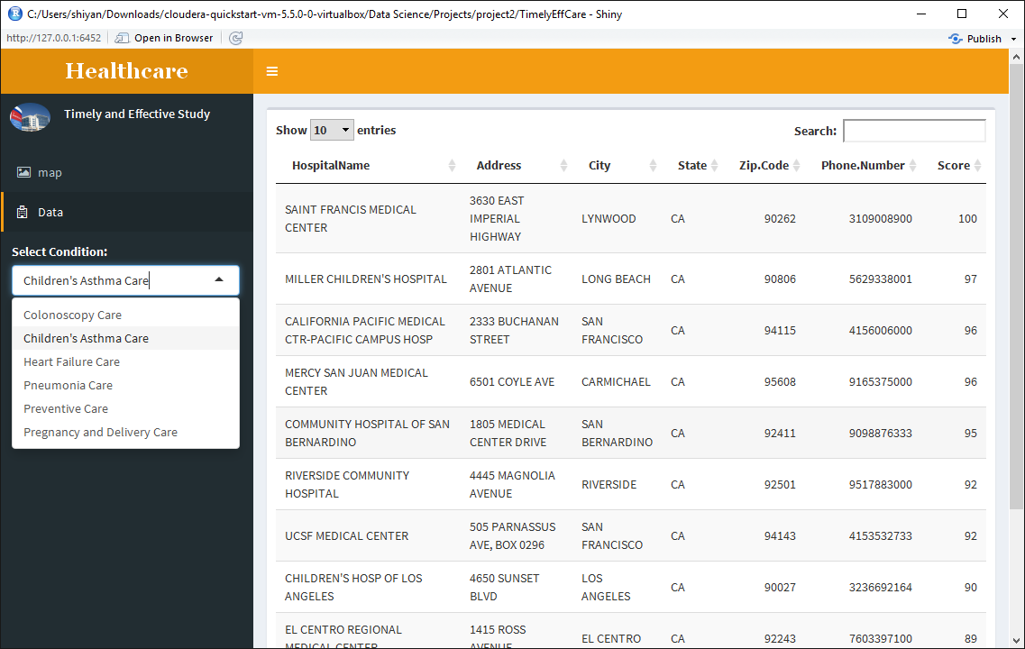
Timely and Effective Care

Slide 9
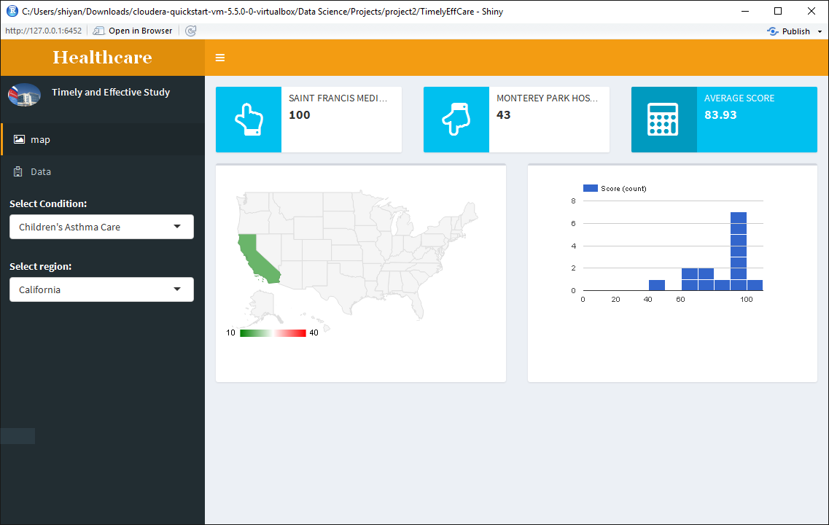
Timely and Effective Care

Slide 10
Timely and Effective Care
Conclusion
Six medical condition have been investigated.
The distribution across US and variation within state has been provided.
The top ranking of states for each condition is available upon user request.
The top ranking of hospital within each state is available for people interested in.

